Slide 1


TAXI FARE ANALYSIS

Slide 2


Problem Definition
Question “How Uber generates so much Revenue?”
Aim is to compare and analyze fare data of large number of trips for Taxi Companies mainly New York Yellow Cabs and Uber.
We will also try to predict the value of surcharge at a given location.
The analysis is focused on New York region only.

Slide 3

Introduction
Analyze how Uber dynamically controls its pricing using the surcharge multiplier parameter.
Uber’s on record rates shown in the App are comparable to other companies but Uber is able to make huge profits using the surcharge it applies.
Ease of Booking the Cab using the App makes the customers lured to using it and Uber takes advantage of this.
We had the dataset of NYC Cabs and we collected the fare data for same locations for Uber and then compared them.

Slide 4
Dataset
NYC Yellow Taxi :
For each trip:
For initial comparison, we focused on four different one hour time buckets, 6 [5:30am-6:30am],10[9:30am-10:30am], 16[3:30pm-4:30pm],20[7:30pm-8:30pm]
We picked up the popular (pickup , dropoff) pairs from the NYC dataset for each time bucket and threw the query to the Uber API.
We crawled Uber Fare data for about 20000 common pickup,dropoff pairs for each hour bucket.
Pickup (Lat,Lon) | Dropoff (Lat,Lon) | Distance (miles) | Duration (seconds) | Total Fare(USD) | Timestamp
Minimum Fare (USD) | Low-High Estimated Fare(USD) | Distance (miles) | Duration (seconds) | Surcharge Multiplier
4

Slide 5
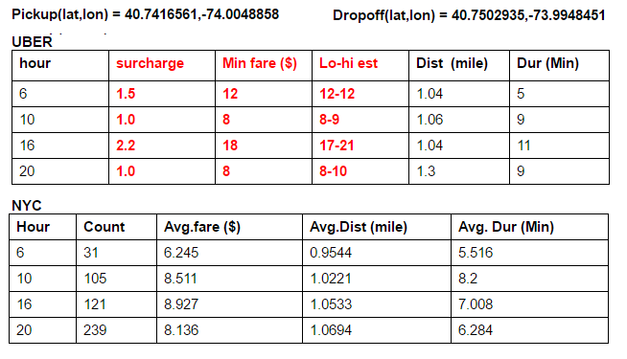
Analyze Data

Slide 6
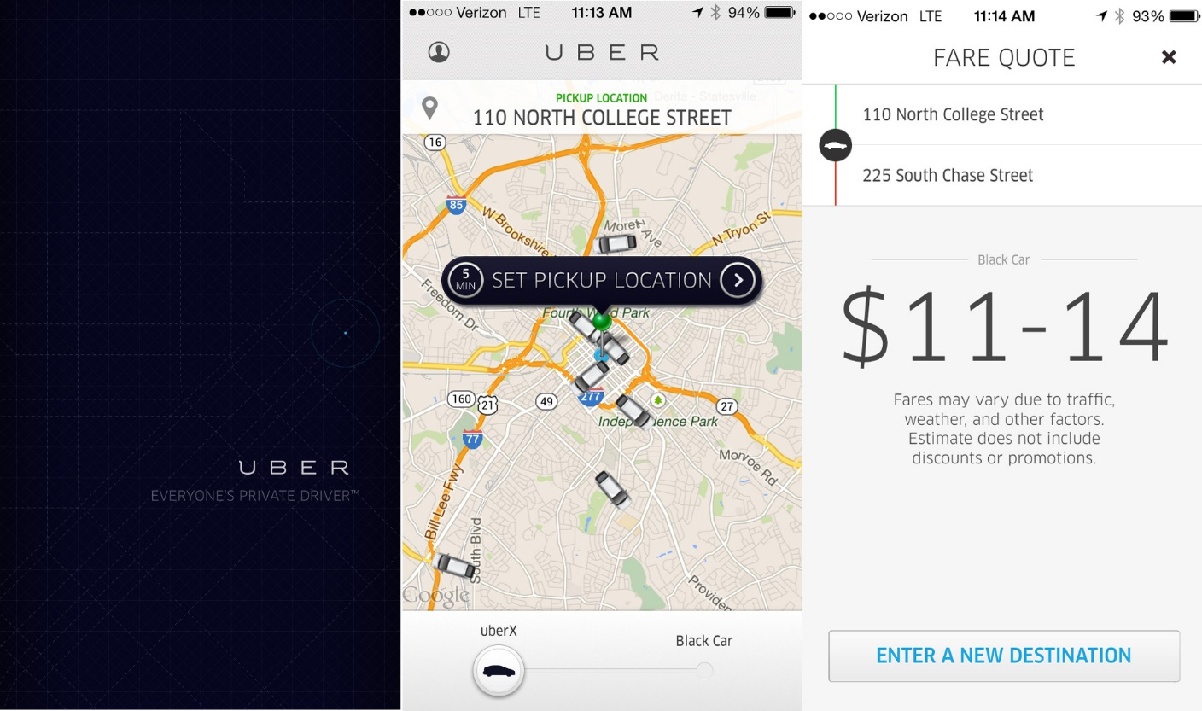
Estimated Fare

Slide 7
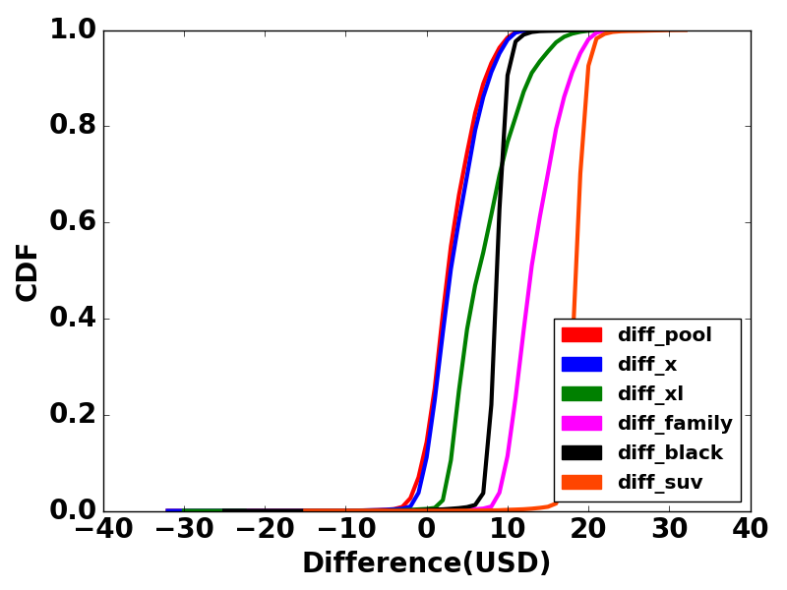
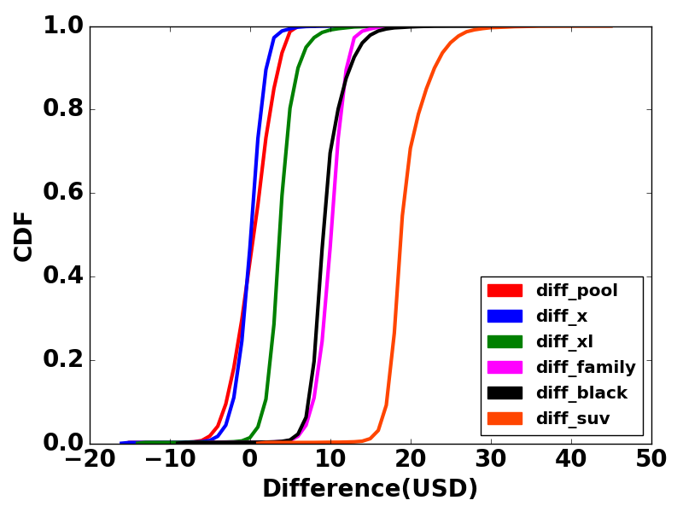
Fare Comparison(Cumulative Distribution Function)
HOUR 6
cheapest uber is costlier than NYC
HOUR 10
Uber almost equal fare to NYC cabs

Slide 8
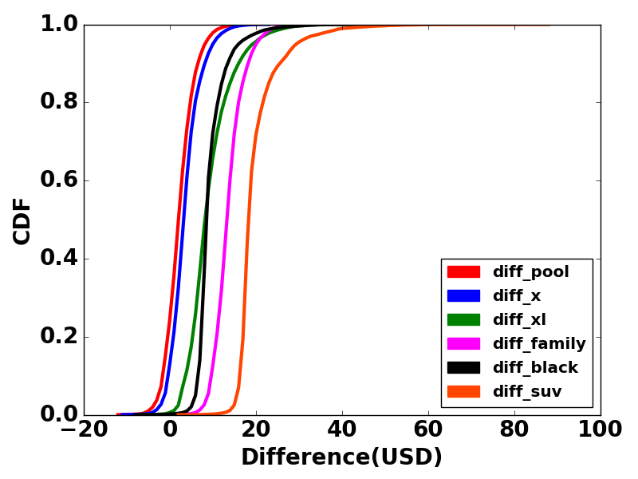
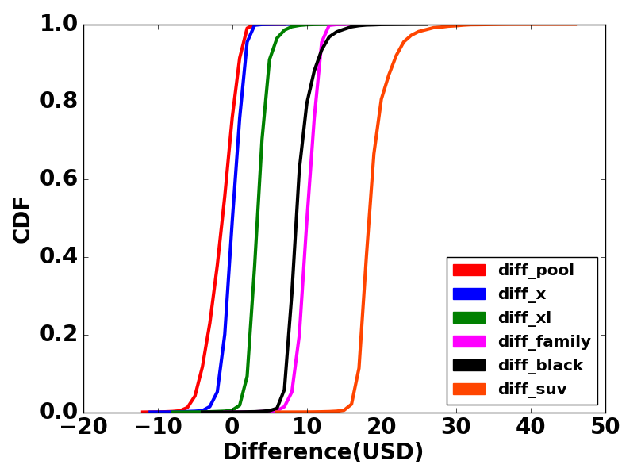
HOUR 16
cheapest uber is costlier than NYC
HOUR 20
Above inferences tell us that uber is costly during early morning and in the evening time when the demand is high.
Uber almost equal fare to NYC cabs

Slide 9
What do the graphs tell us ?
Looking at the blue line (Uber X):
At Hour 6, the difference in fare is mostly greater than zero that is cheapest uber is costlier than NYC.
At Hour 10,the difference in fare is mostly zero or negative that is uber is cheaper or almost equal fare to NYC cabs. Fare decreases during the day.
At Hour 16, the difference is fare is again mostly greater than zero that uber is costlier. cheapest uber is costlier than NYC
At Hour 20, the difference is almost zero mostly, the fare decreases at night. almost equal fare to NYC cabs
Above inferences tell us that uber is costly during early morning and in the evening time when the demand is high.

Slide 10
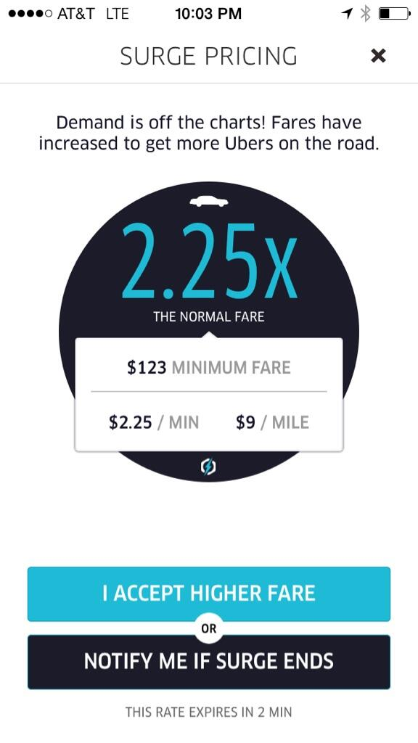
Surcharge Estimator
After doing the analysis ,we found out that uber earns most of the its money by its dynamically changing Surcharge values.
Surcharge Multiplier =
(Demand By Customers)/(Supply of Drivers).
Can we make a model that will predict the surcharge value giving the following inputs
1. pickup location
2. dropoff location
3. Hour
4. cab service

Slide 11
Proposed Model

Slide 12
Generating the Training Set
Assuming uniform supply of drivers. Lets us suppose, surcharge only depends on the Popularity of a pickup location.
Fields:
Latitude of pickup location
Longitude of pickup location
Popularity (Counting the number of trips which started at this location in the NYC Dataset)
Average Surcharge of all the trips having this as pickup location
Pickup Latitude | Pickup Longitude | Popularity | Average Surcharge

Slide 14
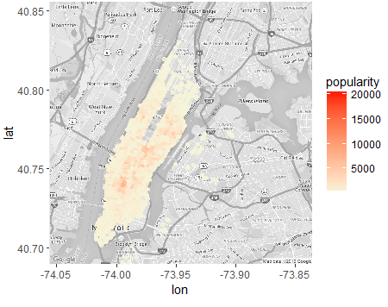
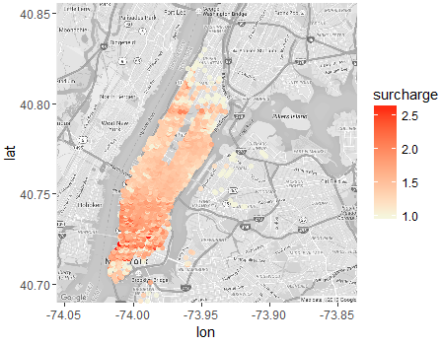
Heatmap(For Hour 16)

Slide 15
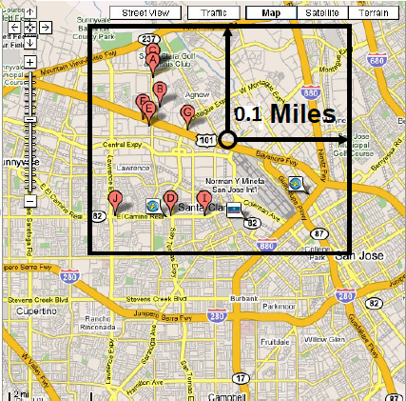


Popularity Estimator
The demand or popularity at a location depends on the popularity of the near by locations.
We start with a distance of 0.1 mile and will go on searching upto 1 mile till we find at least one location.
We can take the average of demand of all locations within the bounding box. This method did not give us good results.
Even within the bounding box ,the location
nearer should have more effect or more weight.
Inverse Distance Weighting Average(IDW)

Slide 16
Surcharge Estimator
After estimating the demand at the location , we have to find the estimated surcharge at the location.
We used different regression algorithms which giving input estimated popularity gave out estimated surcharge at that location at that hour.
Locally Weighted Regression(LWR)
Assumption , estimated value of surcharge should depend on local regions more. We will start searching with radius of the bounding box = 0.1 mile and upto a maximum of 1 mile.
Let X0 be the popularity of the new location.
Find the Euclidean distance of X0,
from its neighbours.
We will use this distance for the
weight function.

Slide 17




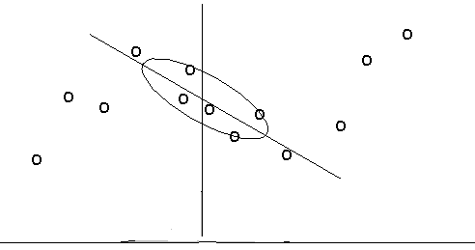
Locally Weighted Regression(LWR)
Inverse Distance Weighting Function
or Gaussian Function used.
After finding the weight diagonal matrix , we will this equation
X is estimated popularity
Y is surcharge

Slide 18
MSE for Surcharge Estimation
Hour | 6 | 10 | 16 | 20
Linear Regression | 0.0297 | 0.0221 | 0.0422 | 0.0239
Decision Tree Regression | 0.02813 | 0.01980 | 0.04089 | 0.0231
Support vector Machine Regression | 0.02806 | 0.02850 | 0.03280 | 0.03920
Locally Weighted Regression(LWR) | 0.0107 | 0.01092 | 0.0105 | 0.01089

Slide 19
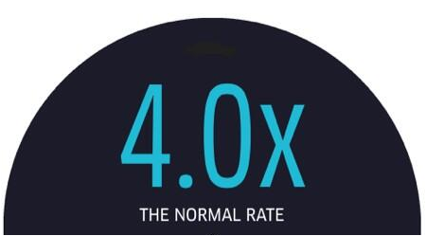

Conclusion
The proposed model estimates the average surcharge at a location with maximum Mean Square Error of 0.01 .
This model can be useful for the user, he can check the estimated surcharge for his location for any hour and compare , analyze the change in surcharge values. He can plan his timings accordingly.
Next Hour

